Slide 1

Customer Shopping Behavior Analysis
Analysis of 3,900 transactions to reveal spending patterns, segments, product preferences, and subscription behavior for strategic decisions.

Slide 2
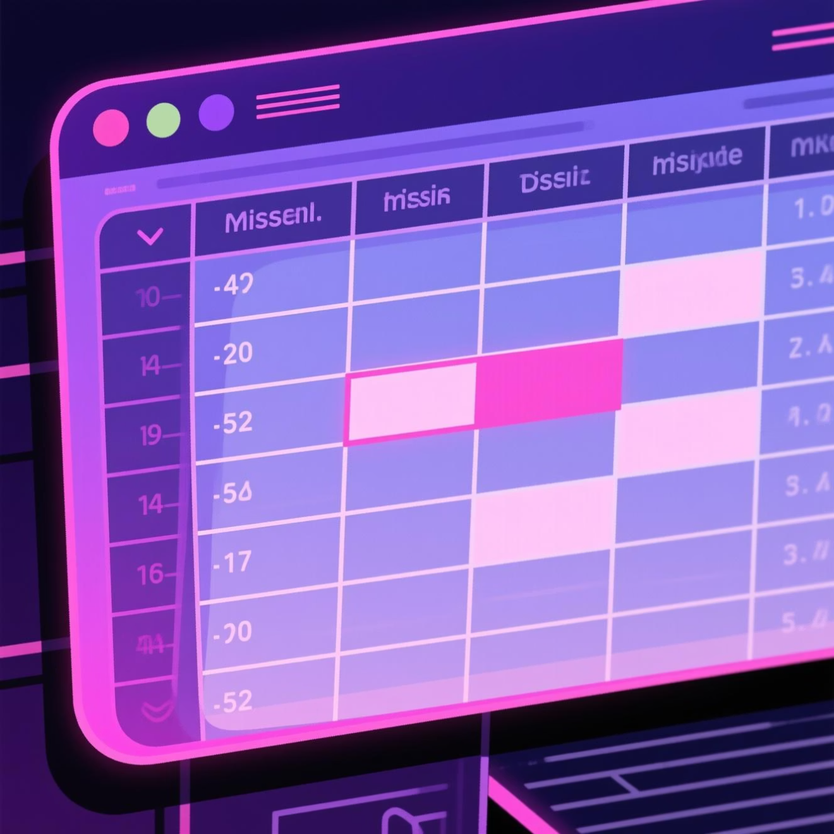
Dataset Summary
Key facts
Data quality
3,900 rows · 18 columns. Features: demographics, purchase details, behavior signals.
37 missing values in Review Rating; other fields largely complete.
Demographics: age, gender, location, subscription
Purchases: item, category, amount, season, size, color
Behavior: discounts, promo codes, frequency, rating, shipping

Slide 3
Data Preparation & Feature Engineering
Loading & Exploration
Imported with pandas; used df.info() and .describe() for structure and stats.
Missing Data
Imputed Review Rating nulls using median per product category.
Standardization
Renamed columns to snake_case for readability and consistency.
Feature Engineering
Added age_group and purchase_frequency_days for richer segmentation.
Integration
Loaded cleaned DataFrame into PostgreSQL for SQL analysis.

Slide 4
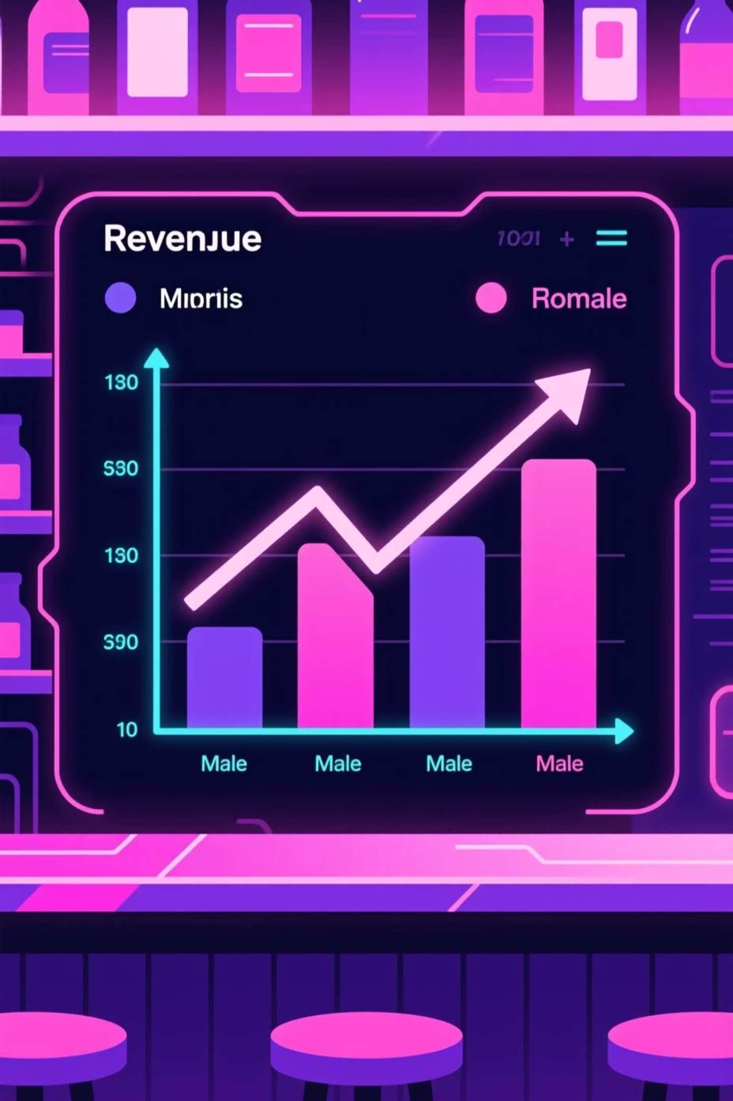
Revenue Overview (SQL Results)
Revenue by Gender
Subscribers vs Non-subscribers
Male: 157,890 · Female: 75,191 — clear skew toward male revenue.
Subscribers (1,053): avg $59.49, total $62,645. Non-subscribers (2,847): avg $59.87, total $170,436.

Slide 5
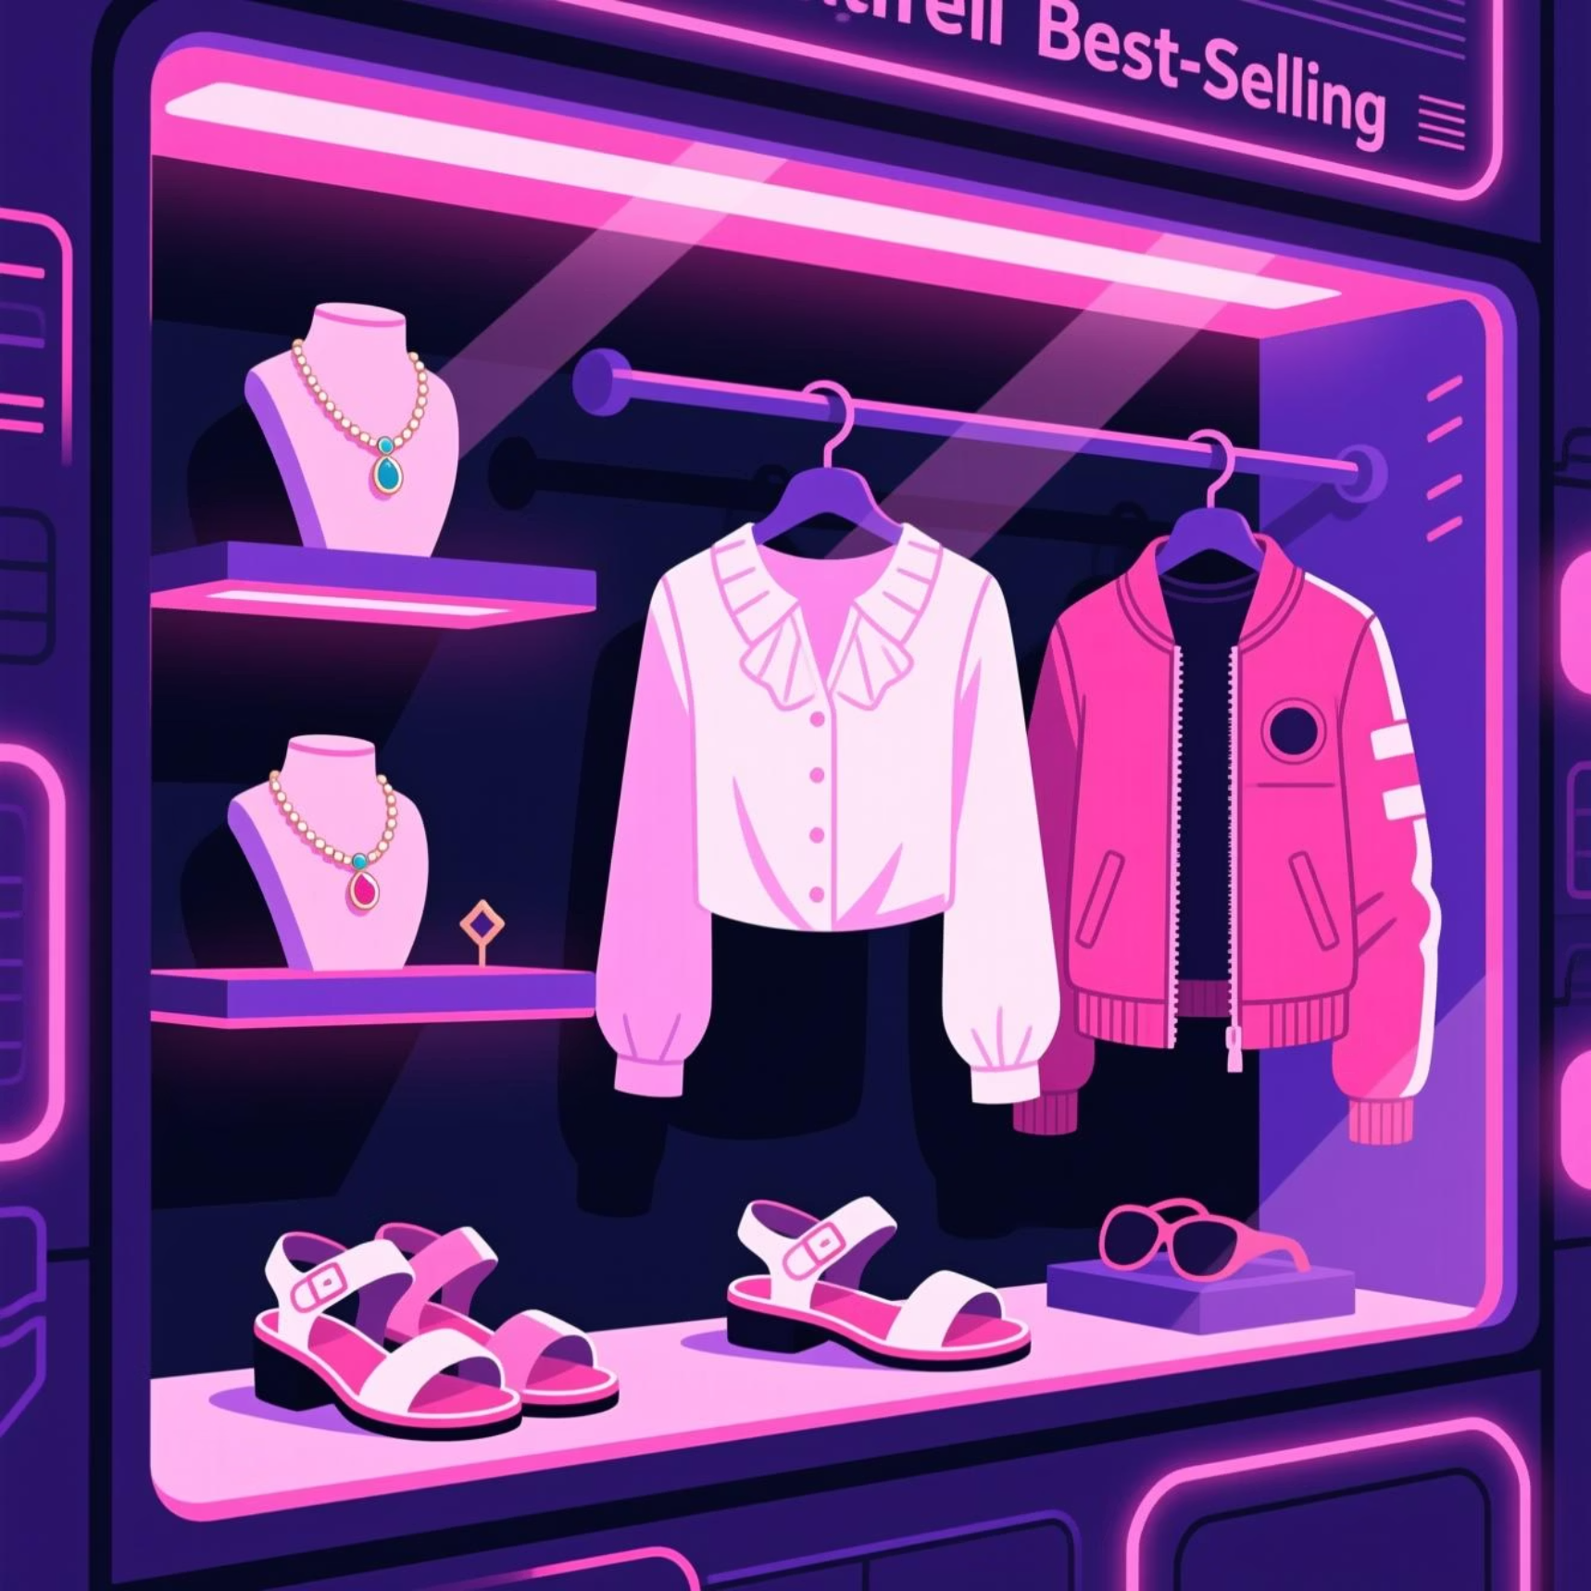
Product & Rating Insights
Top Rated Products
Top Products by Orders
Gloves — 3.86
Examples: Jewelry (171), Blouse (171), Sandals (160), Jacket (163).
Sandals — 3.84
Boots — 3.82
Hat — 3.80
Skirt — 3.78

Slide 6




Discounts & Pricing Behavior
Discount-Dependent Products
High-Spending Discount Users
Top five by discount rate: Hat 50.00%, Sneakers 49.66%, Coat 49.07%, Sweater 48.17%, Pants 47.37%.
Identified customers using discounts yet spending above average — 839 rows highlighted.

Slide 7
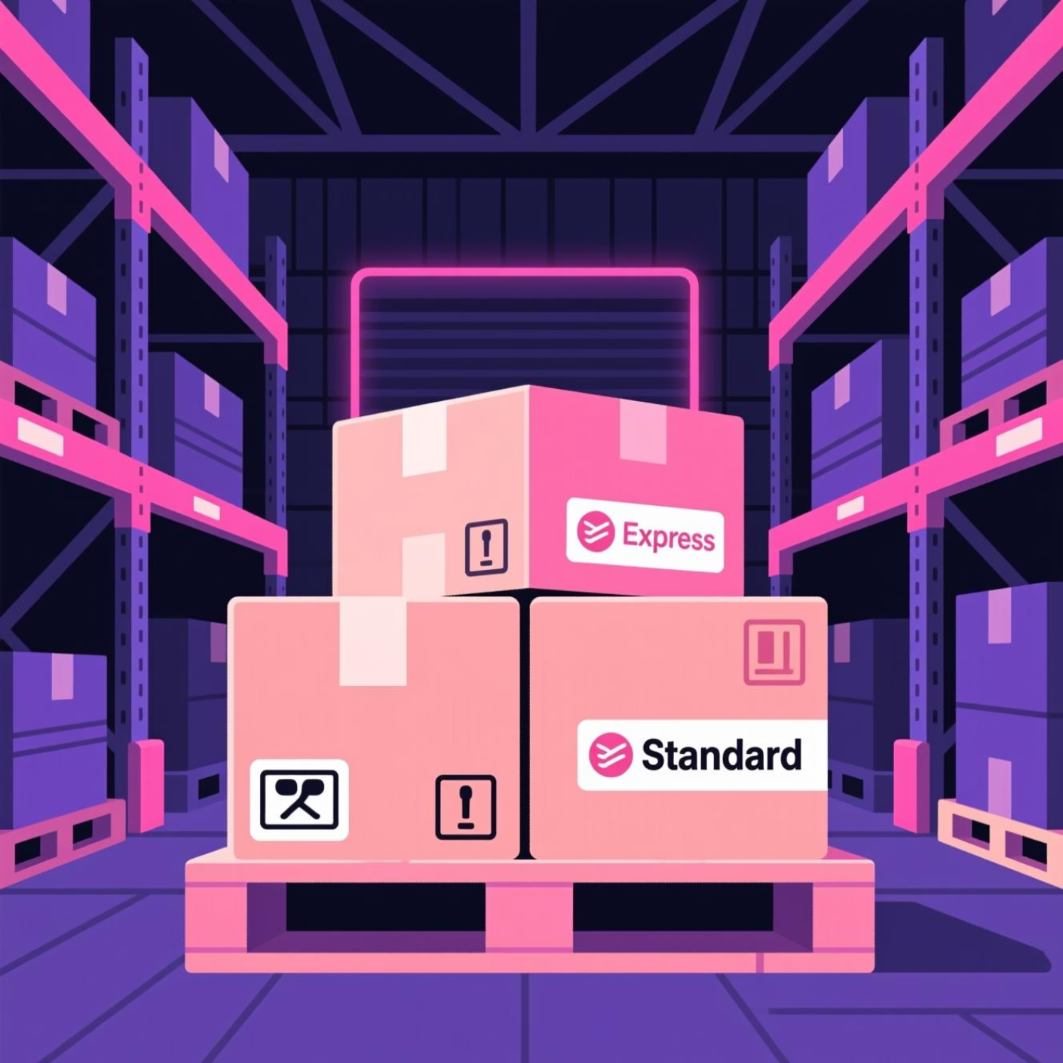

Shipping & Payment Patterns
Shipping Comparison
Average purchase: Standard $58.46 · Express $60.48 — express slightly higher.
Payment Methods
Common methods observed (example): PayPal frequent in records.

Slide 8



Customer Segmentation
Loyal
New
Returning
3,116 customers — primary cohort for retention strategies.
83 customers — high-potential but small group.
701 customers — engage to move toward loyalty.

Slide 9
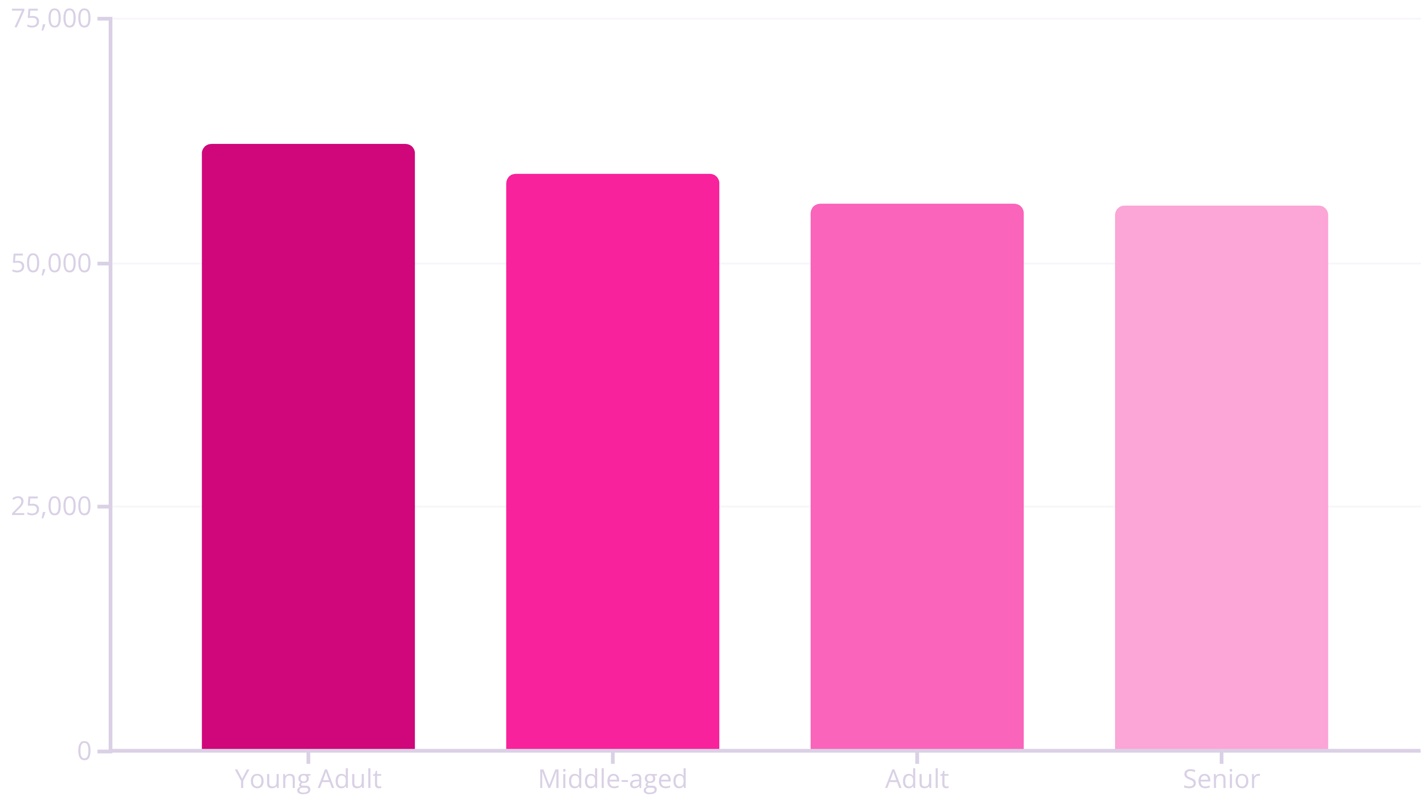
Revenue by Age Group
Target marketing toward Young Adult and Middle-aged segments for maximum revenue lift.

Slide 10

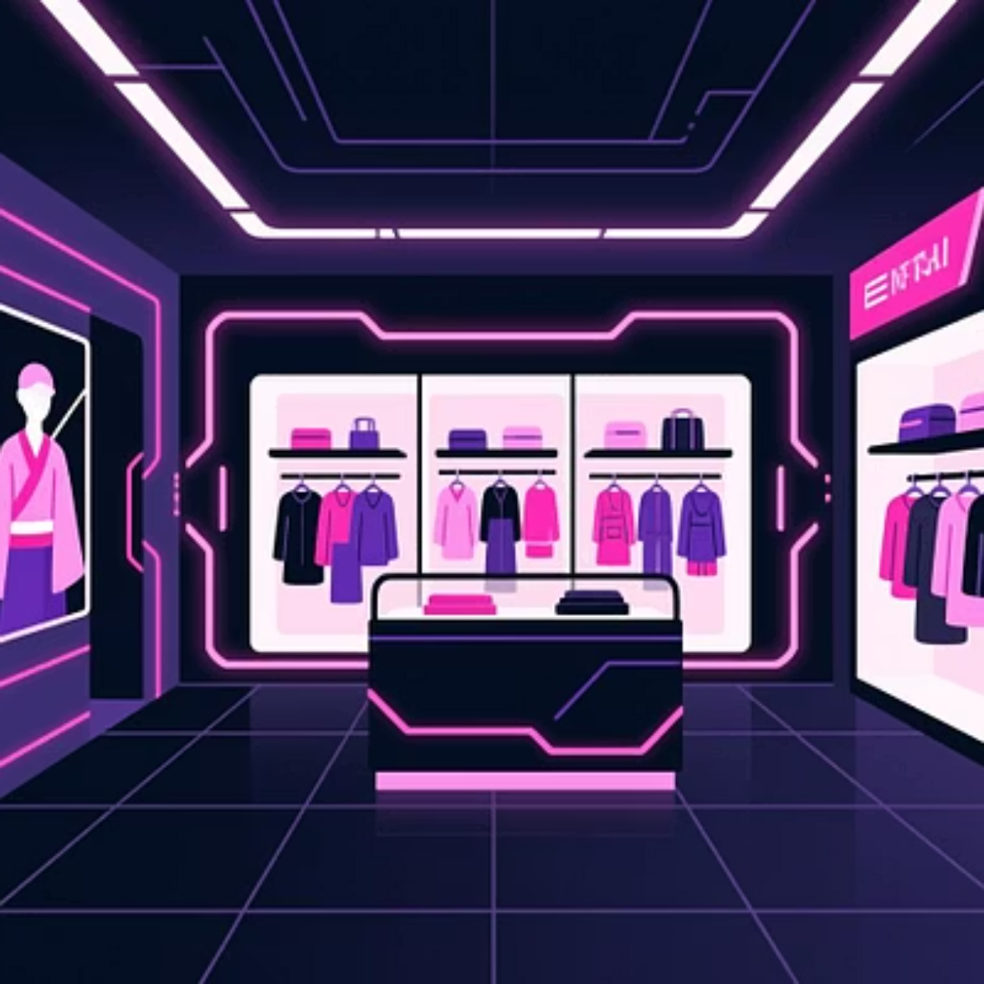

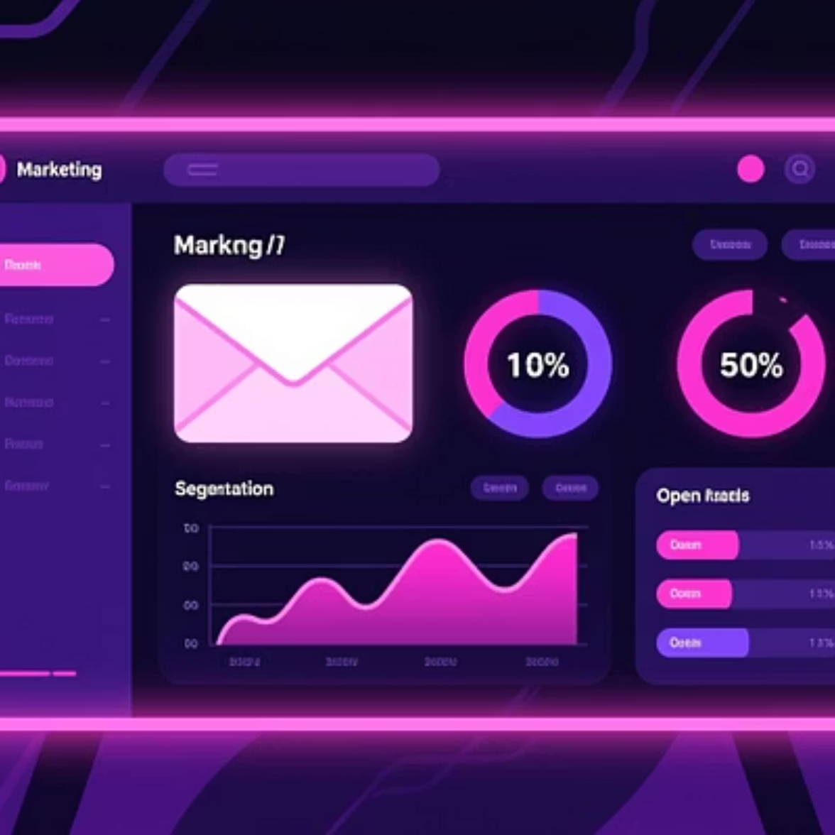
Recommendations & Next Steps
Boost Subscriptions
Loyalty Programs
Promote exclusive subscriber benefits to increase conversion among repeat buyers.
Reward repeat buyers to shift more customers into the Loyal segment.
Review Discount Policy
Product Positioning & Targeting
Balance promotional lift with margin control; focus on high-discount items.
Highlight top-rated and best-selling products in campaigns; target high-revenue age groups and express-shipping customers.

